Slide 1






Hierarchically gated recurrent neural network for sequence modeling
Md Siam Sadman Azad
id# 2014002

Slide 2

introduction
Transformers vs rnn in sequence modeling
1. Dominated sequence modeling for years (machine translation, speech recognition)
2. Sequential training slowed them down (like running through a maze)
3. Limited long-term dependency modeling (struggling with long sentences)
Transformer’s popularity due to parallel training and long-term dependency modeling.
RNN drawbacks: slow training and limited long-term dependency modeling
Our goal: Revitalize RNN applicability in long-sequence tasks

Slide 3



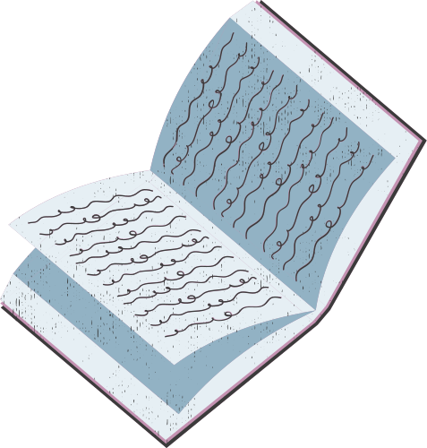
the transformer takeover
transformers: blazing fast, but costly
Parallel training revolutionized speed
Powerful long-term dependency modeling
High computational cost for long sequences
Quadratic time complexity challenges for long sequences

Slide 4
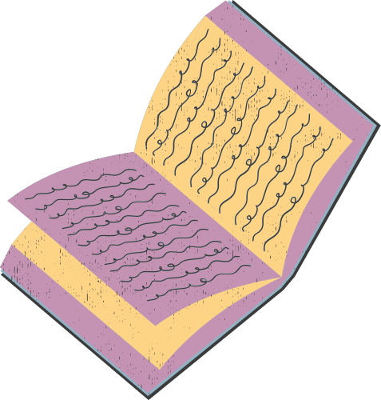

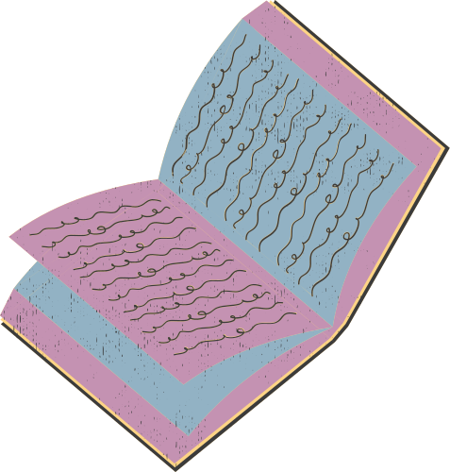
The Return of the RNN, Reinvented
HGRN: Bringing Back the Efficiency with Gating Power
Combines efficiency of linear RNNs (element-wise operations)
Gating mechanisms like LSTMs for improved performance
Unique "lower bound" for forget gates (adjustable valves for memory)
Introduction of HGRN - Hierarchically Gated Recurrent Neural Network
Focus on forget gates and their significance

Slide 5
Gating with forgetfulness
why is matters
"Gating with Forgetfulness: Why it Matters" explores the critical role of forget gates in linear RNNs, emphasizing their significance often overlooked in contemporary studies. This paper introduces the Hierarchically Gated Recurrent Neural Network (HGRN), a model that enhances forget gates with a learnable lower bound, providing a nuanced approach to balancing long-term dependency modeling and efficient forgetting in sequence tasks.
Forget gates discard irrelevant information from the past
HGRN's lower bound prevents them from getting stuck (on/off)
Lower layers focus on short-term dependencies (recent words)
Upper layers capture long-term connections (sentence meaning)

Slide 6

Performance that Speaks for Itself
HGRN: Benchmark Champion
Language modeling: Outperforms other models in accuracy and efficiency
Image classification: Achieves state-of-the-art results
Long-range arena benchmarks: Demonstrates superior long-term dependency modeling

Slide 7



conclusion
HGRN: Opening Doors to the Future, A New Era in Sequence Modeling
A testament to the resilience of RNNs and the power of innovation
Efficient, flexible, and accurate for short and long sequences
Potential to revolutionize various domains (natural language processing, computer vision)
Explore the vast potential of HGRN
Push the boundaries of sequence modeling
Build a future where AI truly understands our world
HGRN's contribution to long-sequence modeling
Striking a balance between RNN and Transformer efficiency

Slide 8

thank you for your time
hope to see you at the next one

